Slide 1
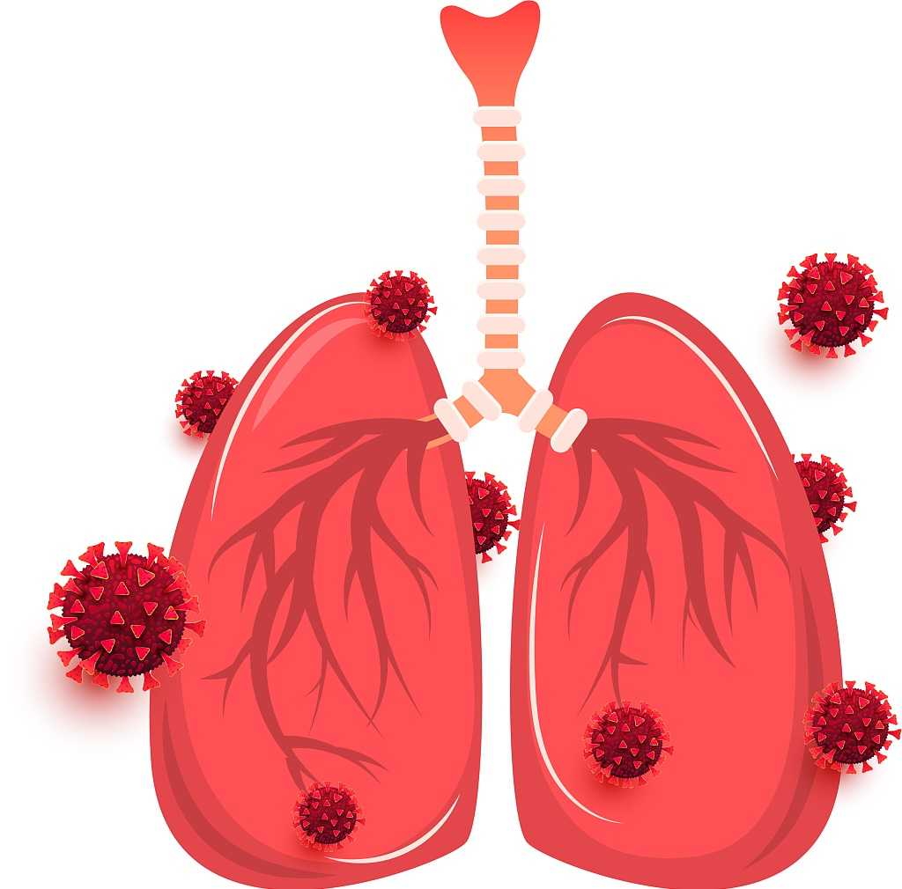

Pandemic prediction
presentation
Qiyuan Shen
Zihao Wei

Slide 2
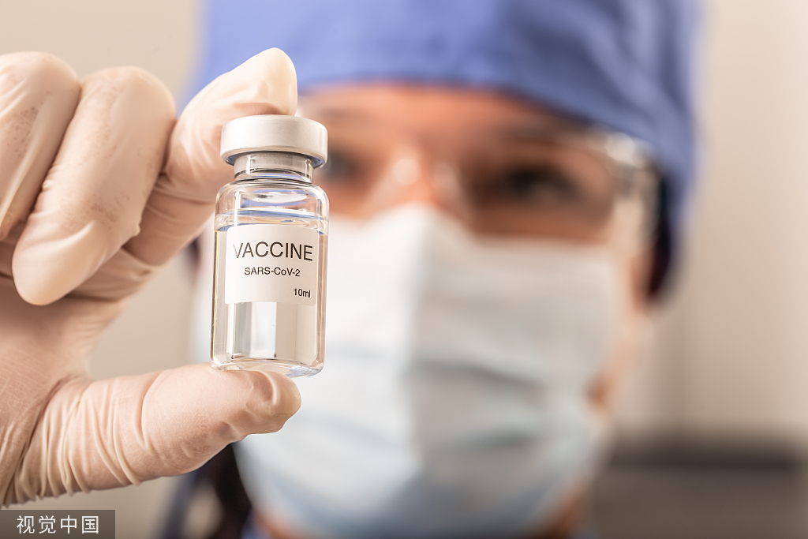
contents
01
Background
02
Problem Statement
03
Proposed Method
04
Results
05
Conclusion

Slide 3
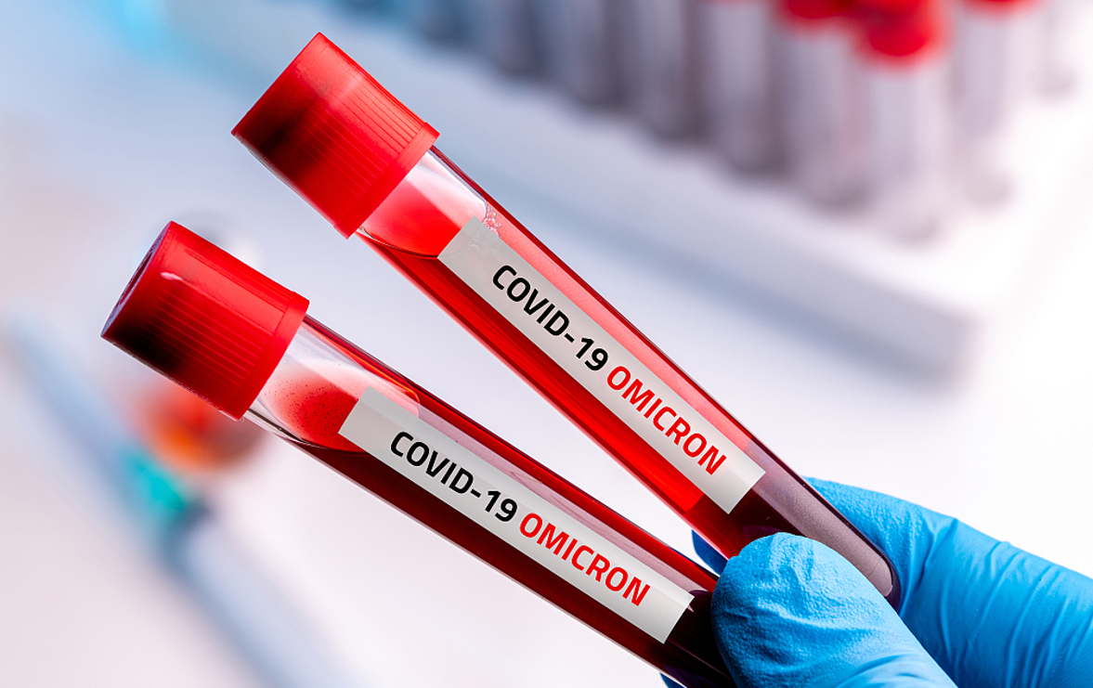
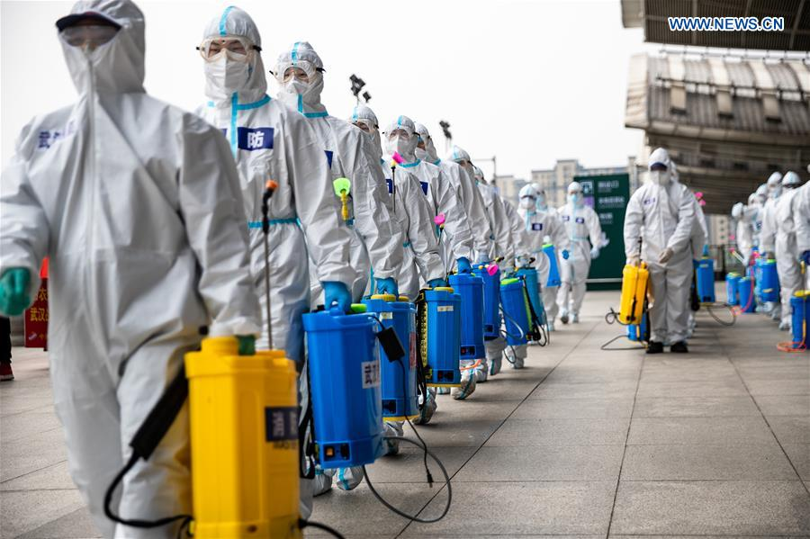
Background
01
Sourced from: https://www.vcg.com/creative/1359720968 & https://covid-19.chinadaily.com.cn/a/202006/08/WS5edd8bd6a3108348172515ec.html
Notes:
personal protective equipment

Slide 4
Problem Statement
02
Research goal:
Predict the volume of the existing COVID-19 cases in the future
Notes:
personal protective equipment

Slide 5
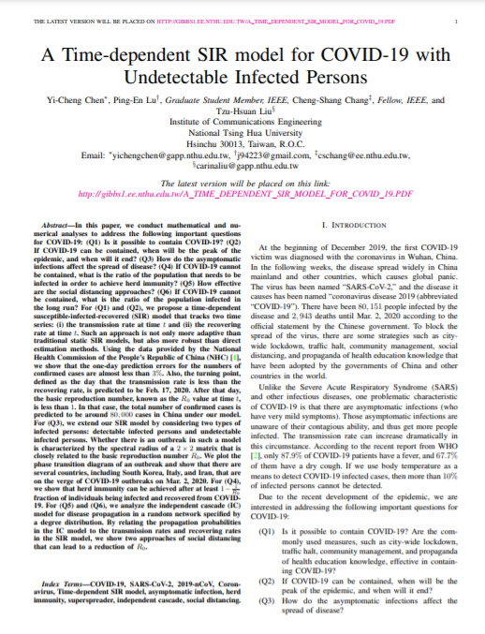
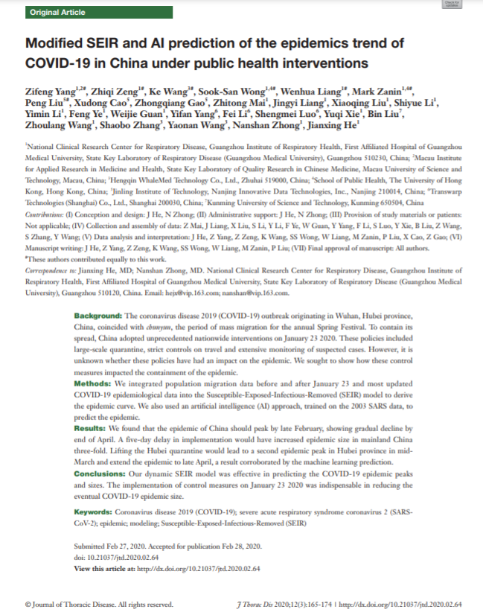
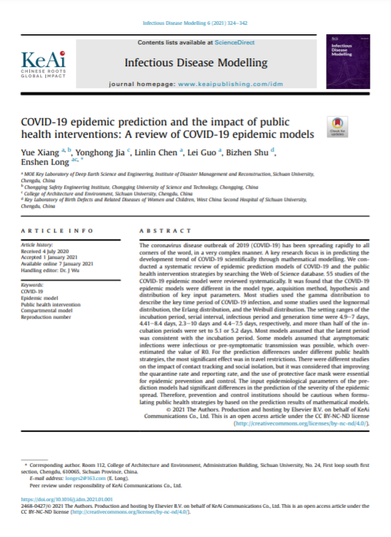
Problem Statement
02
Works in related fields
Notes:
personal protective equipment

Slide 6
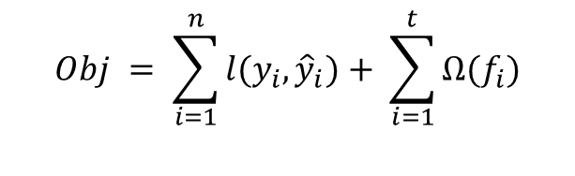
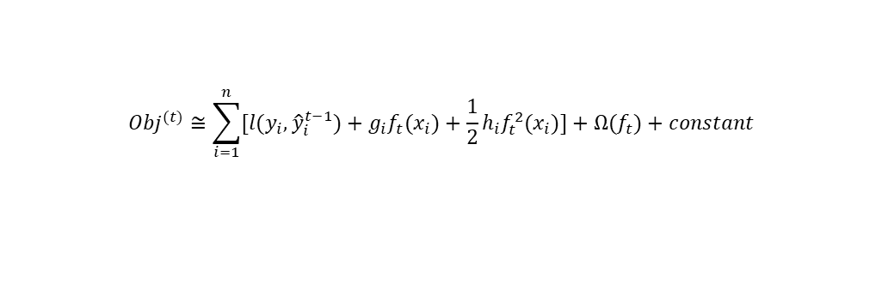
Proposed Method
03
XGBoost
$$Obj = \sum_{i=1}^{n}{l(y_{i},{\hat{y}}_{i})}+ \sum_{i=1}^{t}{Ω(f_{i})}$$
20
(14,16,24,26)
20
(14,16,24,26)
0
(-1,1,-1,1)
15
(14,16)
25
(24,26)
15
(14,16)
25
(24,26)
-1
(-1,-1)
1
(1,1)
$${Obj}^{(t)}≅\sum_{i=1}^{n}{[l(y_{i},{\hat{y}}_{i}^{t−1})}+g_{i}f_{t}(x_{i})+\frac{1}{2}h_{i}f_{t}^{2}(x_{i})]+Ω(f_{t})+constant$$
Residual: A=-1, B=1
C=-1, D=1
A=0, B=0
C=0, D=0
14
16
24
26
Notes:
personal protective equipment

Slide 7
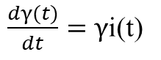
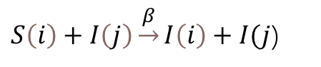
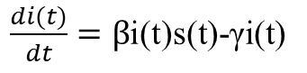
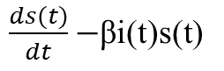
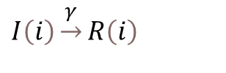
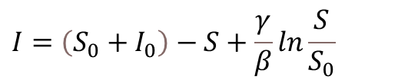
Proposed Method
03
SIR Model
Main idea
Sliding window
Window
Prediction
N(t)=C=S(t)+I(t)+R(t)
V1
V2
V3
V4
V5
V6
$S\left(i\right)+I\left(j\right)\underset{→}{β}I\left(i\right)+I(j$)
$$I\left(i\right)\underset{→}{γ}R\left(i\right)$$
Move
V1
V2
V3
V4
V5
V6
$\frac{ds(t)}{dt}−$βi(t)s(t)
$\frac{di(t)}{dt}=β$i(t)s(t)-γi(t)
Daily updated β, γ
Move
$\frac{dγ(t)}{dt}=γ$i(t)
V1
V2
V3
V4
V5
V6
$$I=\left(S_{0}+I_{0}\right)−S+\frac{γ}{β}ln\frac{S}{S_{0}}$$
Notes:
personal protective equipment

Slide 8
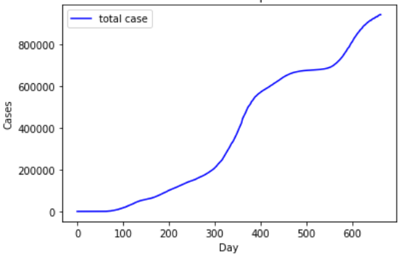
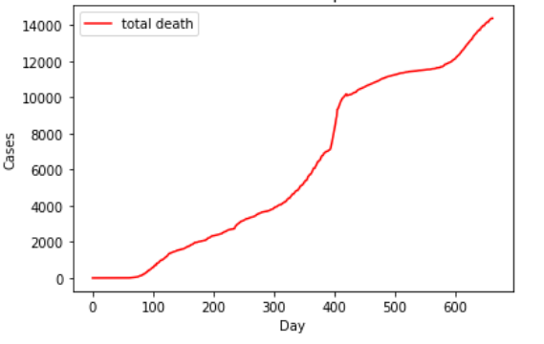
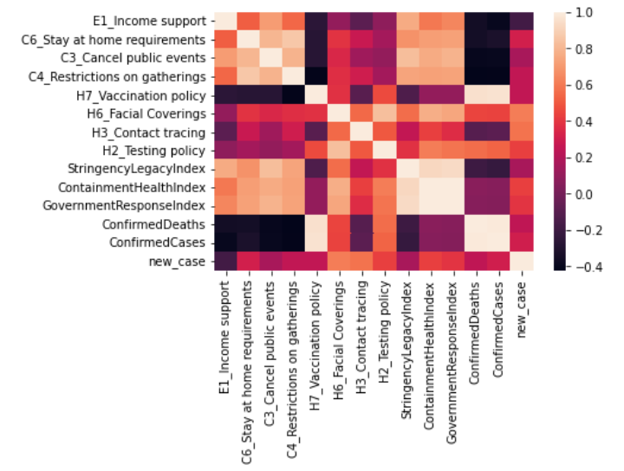
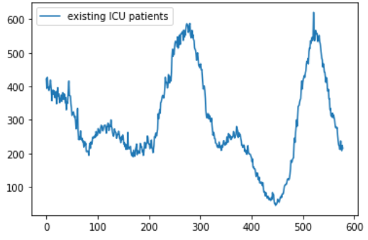
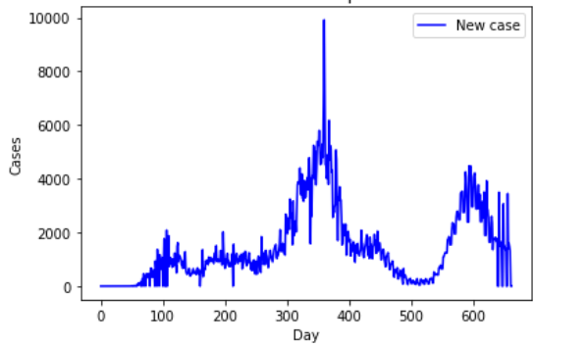
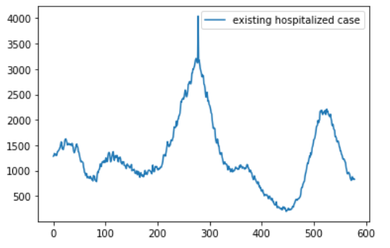
Proposed Method
03
Dataset Overview
Intervention
Period: 2020/01/01-2021/11/14
Important Features:
1. Overall policy index (government response index)
2. Certain policy index (H6_facial_covering)
Source: UC Berkely COVIDVIS Team
Hospitalization
Period: 2020/04/14-2021/11/14
Important Features:
1. Hospitalized cases
2. ICU cases
Source: Virginia Open Data Portal
Overall Cases in Virginia
Period: 2020/01/22-2021/11/14
Important Features:
1. Total/new cases
2. Total/new death
Source: Centers for Disease Control and Prevention
Notes:
personal protective equipment

Slide 9
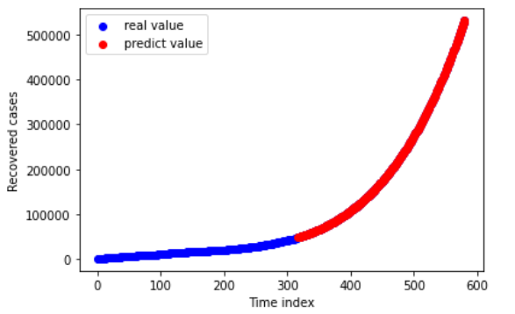
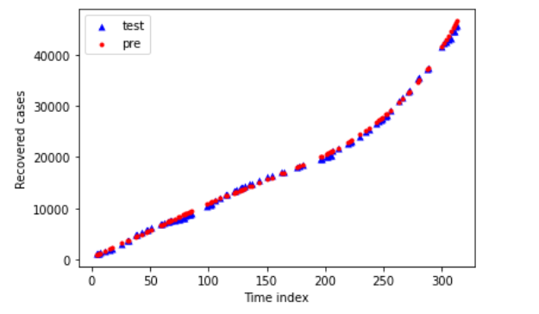
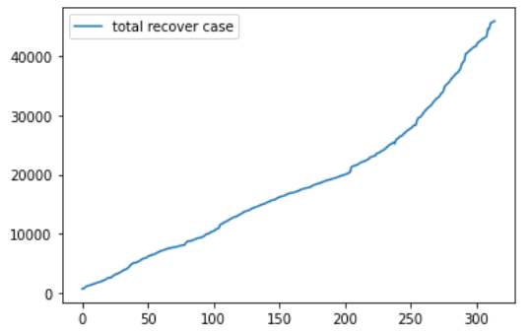
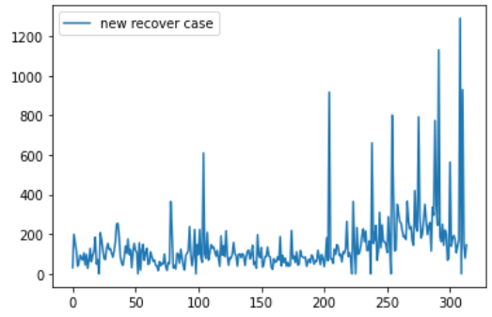
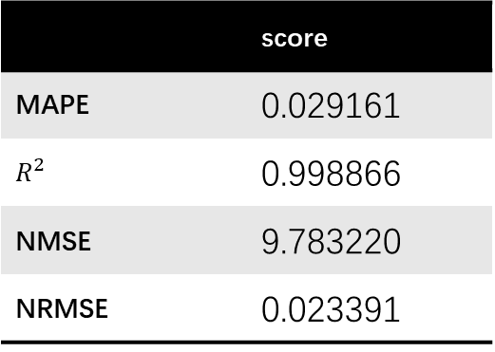
Proposed Method
03
Dataset Overview
Recovered case
Period: 2020/04/14-2021/02/22
Important Features:
1. Total recovered cases
2. New recovered cases
Source: Johns Hopkins University Center for Systems Science and Engineering
Data processing
1. Data cleaning
a. Cleaning missing and zero values
b. Feature unification
2. Predicting the recover data
 | score
MAPE | 0.029161
$$R^{2}$$ | 0.998866
NMSE | 9.783220
NRMSE | 0.023391
Notes:
personal protective equipment

Slide 10
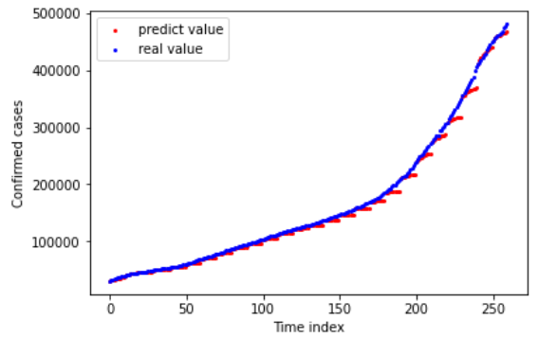
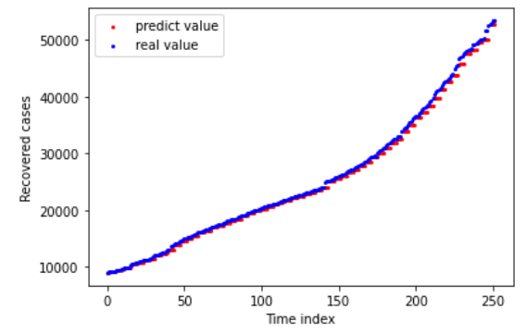
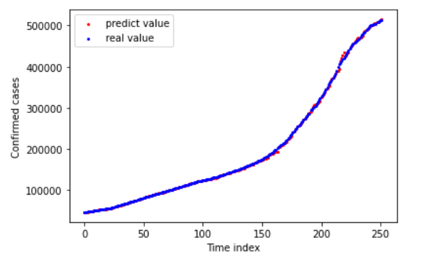
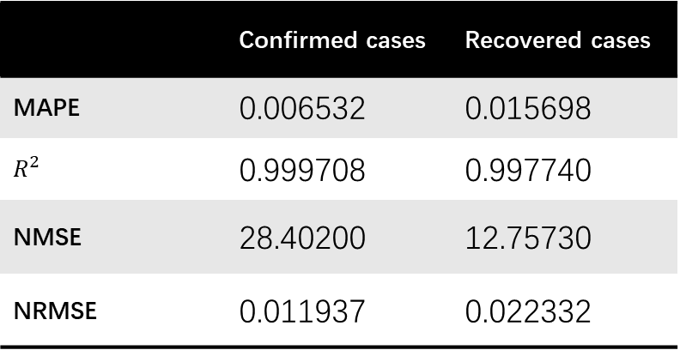
Results
04
SIR Model
Sliding window
Window range: 60 days
Predict range: 4 days
 | Confirmed cases | Recovered cases
MAPE | 0.006532 | 0.015698
$$R^{2}$$ | 0.999708 | 0.997740
NMSE | 28.40200 | 12.75730
NRMSE | 0.011937 | 0.022332
Notes:
personal protective equipment

Slide 11
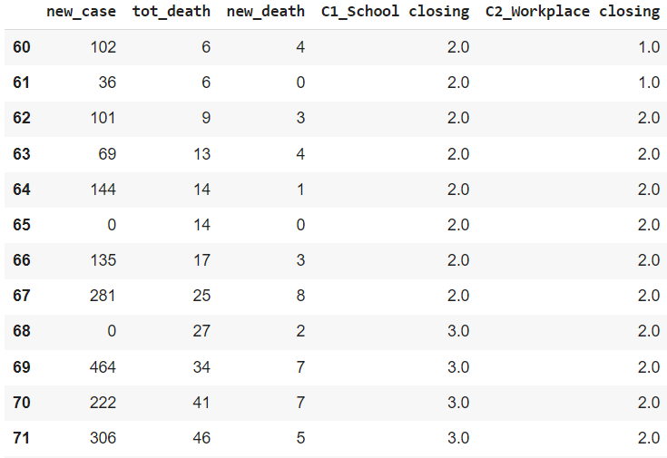
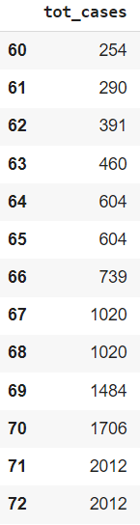
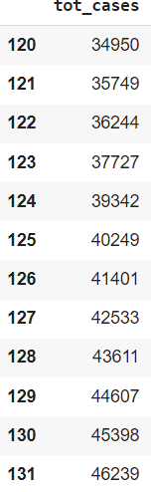
Results
04
XGBoost
Lagged behind for 60 days
Notes:
personal protective equipment

Slide 12
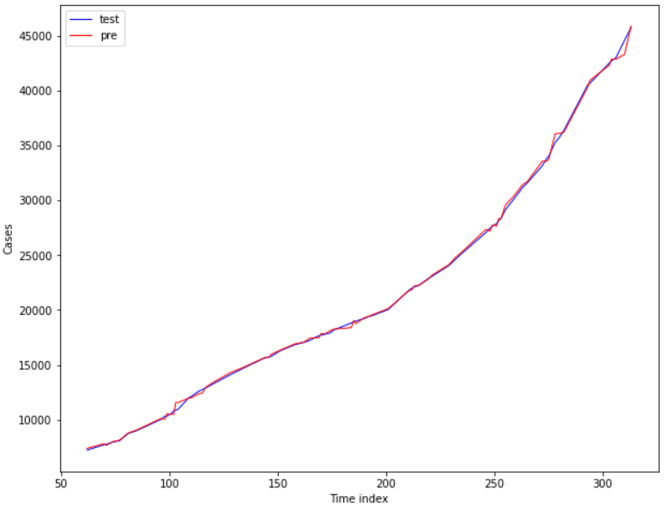
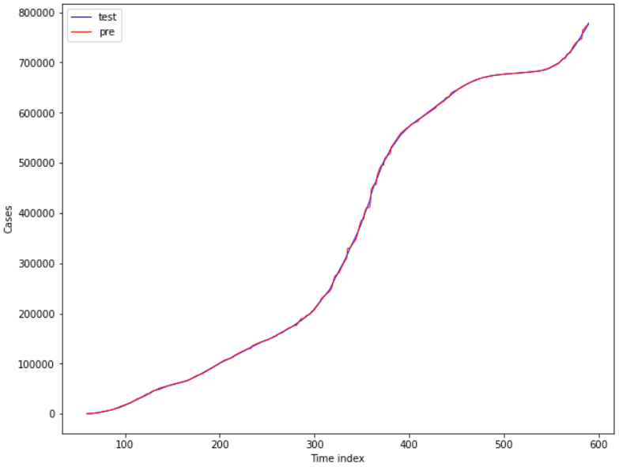
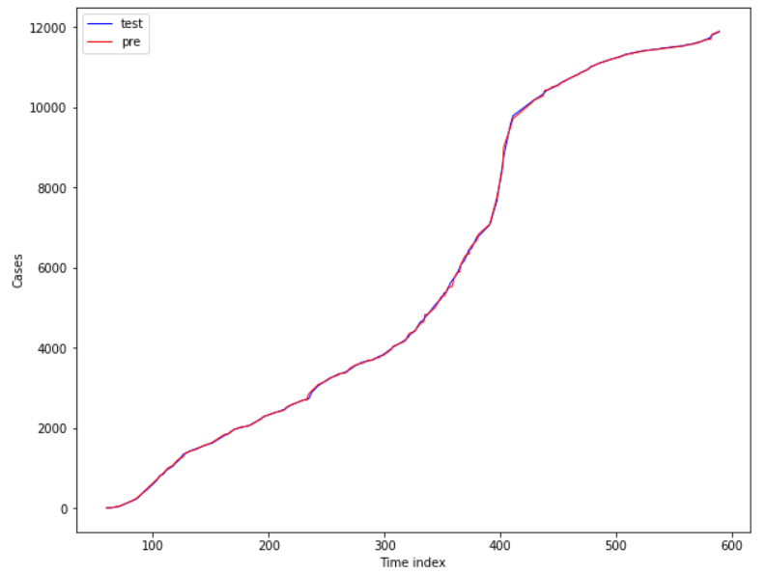
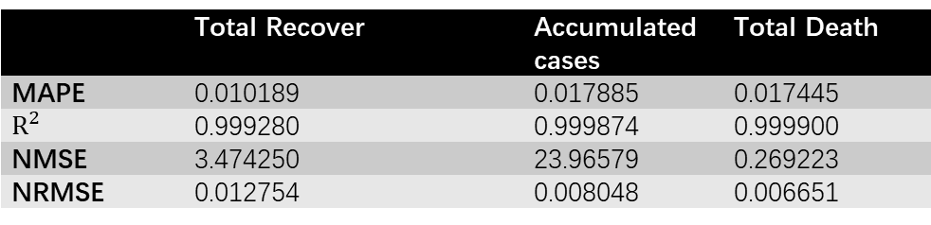
Results
04
XGBoost
Total recover
Accumulated cases
Total death
 | Total Recover | Accumulated cases | Total Death
MAPE | 0.010189 | 0.017885 | 0.017445
$$R^{2}$$ | 0.999280 | 0.999874 | 0.999900
NMSE | 3.474250 | 23.96579 | 0.269223
NRMSE | 0.012754 | 0.008048 | 0.006651
Notes:
personal protective equipment

Slide 13
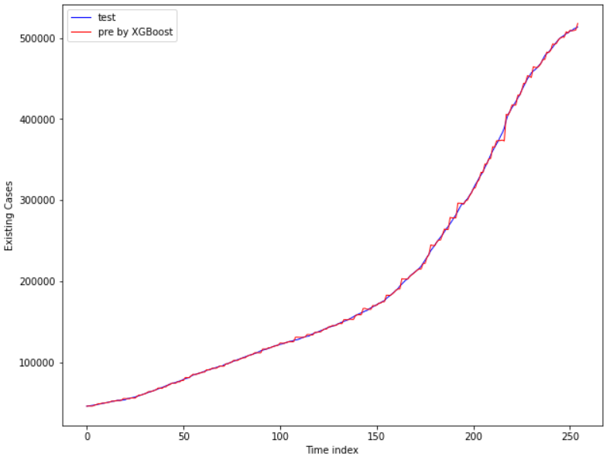
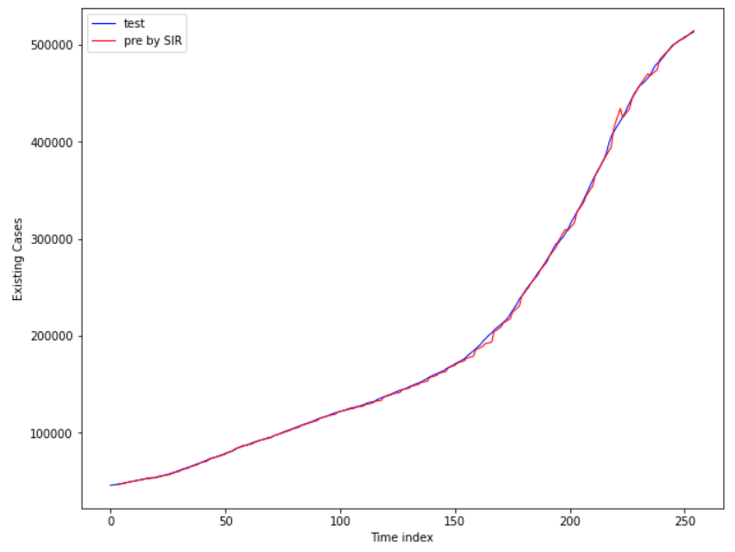
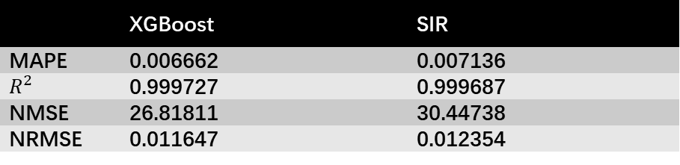
Results
04
Existing case
XGBoost
SIR
 | XGBoost | SIR
MAPE | 0.006662 | 0.007136
$$R^{2}$$ | 0.999727 | 0.999687
NMSE | 26.81811 | 30.44738
NRMSE | 0.011647 | 0.012354
Notes:
personal protective equipment

Slide 14
Conclusion
05
1. Achieved a satisfying result in predicting the volume of existing cases 60 days later in the future by XGboost
2. Verified that the policy intervention has a deep relationship with Covid-19 situations
Need to find a new method to support SIR to make a long-term prediction.
We have only tested our model on the dataset about Virginia. More data is welcomed to test the generalization of such a method.
Notes:
personal protective equipment

Slide 15
References
06
[1] Edomt. 2021. “Data on COVID-19 (coronavirus) vaccinations by Our World in Data” Github. November 10, 2021, https://github.com/owid/covid-19-data/tree/master/public/data/vaccinations
[2] Virginia Department of Health. 2021. “VDH-COVID-19-PublicUseDataset-KeyMeasures-Hospitals” Virginia Open Data Portal, November 9, 2021, https://data.virginia.gov/Government/VDH-COVID-19-PublicUseDataset-KeyMeasures-Hospital/28wk-762y
[3] CDC Case Task Force, “United States COVID-19 Cases and Deaths by State over Time”, Centers for Disease control and prevention, November 14, https://data.cdc.gov/Case-Surveillance/United-States-COVID-19-Cases-and-Deaths-by-State-o/9mfq-cb36
[4] Johns Hopkins University Center for Systems Science and Engineering, “csse_covid_19_daily_reports_us”, Github, December 1,2021, https://github.com/CSSEGISandData/COVID-19/tree/master/csse_covid_19_data/csse_covid_19_daily_reports_us
[5] Xiang, Yue, Yonghong Jia, Linlin Chen, Lei Guo, Bizhen Shu, and Enshen Long. “Covid-19 Epidemic Prediction and the Impact of Public Health Interventions: A Review of COVID-19 Epidemic Models.” Infectious Disease Modelling 6 (2021): 324–42. https://doi.org/10.1016/j.idm.2021.01.001.
[6] Chen, Yi-Cheng, Ping-En Lu, Cheng-Shang Chang, and Tzu-Hsuan Liu. “A Time-Dependent SIR Model for COVID-19 with Undetectable Infected Persons.” IEEE Transactions on Network Science and Engineering 7, no. 4 (2020): 3279–94. https://doi.org/10.1109/tnse.2020.3024723.

Slide 16
References
06
[7] Yang, Zifeng, Zhiqi Zeng, Ke Wang, Sook-San Wong, Wenhua Liang, Mark Zanin, Peng Liu, et al. “Modified Seir and AI Prediction of the Epidemics Trend of COVID-19 in China under Public Health Interventions.” Journal of Thoracic Disease 12, no. 3 (2020): 165–74. https://doi.org/10.21037/jtd.2020.02.64.

Slide 17
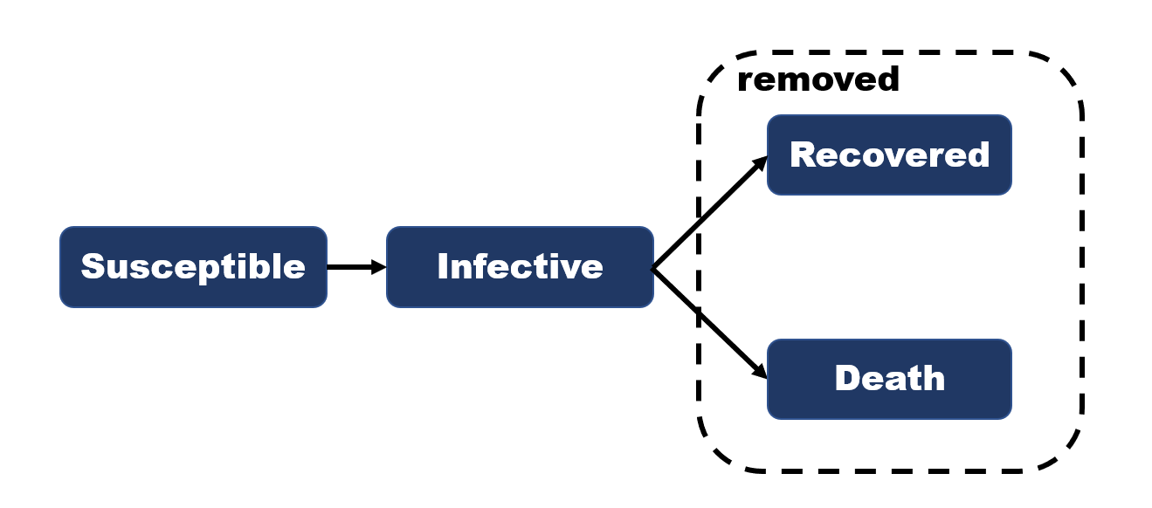
recover
COVID-19 cases
input
SIR model
γ(t)
β(t)
output
Existing case
Recovered case
γ(t+1), β(t+1)

Slide 18

Q&A
08

